Slide 1
Locations (Where)

Slide 2
unleaded / ʌnˈledəd, ʌnˈledɪd / adjective describes a type of petrol or other substance that does not contain lead:
- Does your car use unleaded petrol?

Slide 3
windscreen / ˈwɪndskriːn / = windshield / ˈwɪndʃiːld / noun the window at the front of a car, truck etc.

Slide 4
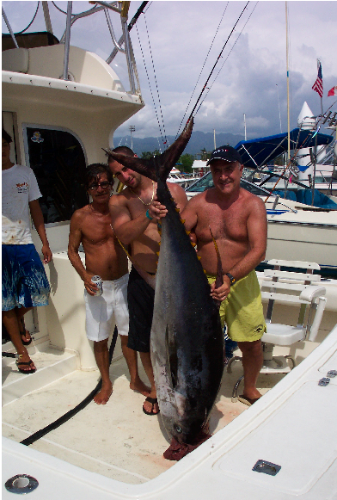

Slide 5
tuna/ˈtjuːnə ,ˈtuːnə/ noun a large sea fish caught for food

Slide 6
dessert / dɪˈzɜːt / noun sweet food served after the main part of a meal for dessert
- What are we having for dessert?

Slide 7
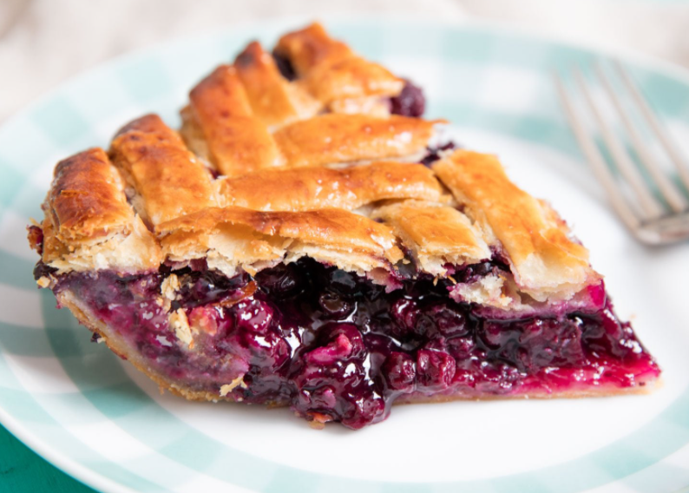

Slide 8
pie noun a dish composed of fruit, meat, cheese, or other ingredients baked over, under, or surrounded by a crust of pastry or other dough.
- Would you like another piece of apple pie?

Slide 9
overdue adjective not done or happening when expected or when needed; late
- The baby is two weeks overdue (= The baby was expected to be born two weeks ago).

Slide 10
check out phrasal verb
American English to borrow a book from a library :
- The library allows you to check out six books at a time.

Slide 11
_{loan / ləʊn / noun}
1 an amount of money that you borrow from a bank etc
_{loan of}
_{- a loan of £60,000}
- I had to take out a loan to buy my car.
2 when you lend something to someone
_{loan of}
- Thanks for the loan of your camera.

Slide 12
lift = elevator

Slide 13
chequebook = checkbook / ˈtʃekbʊk / noun a book of cheques with your name printed on them which is given to you by your bank to make payments with

Slide 14
chequebook = checkbook a book of cheques with your name printed on them which is given to you by your bank to make payments with

Slide 15
savings account noun a bank account in which you keep money that you want to save for a period of time, and which pays you interest on the money you have in it

Slide 16
checking account noun American English a bank account that you can take money out of at any time, and for which you are given checks to use to pay for things SYN current account British English

Slide 17
agency / ˈeɪdʒənsi / noun a business that provides a particular service for people or organizations an advertising/employment/travel etc agency
- a local housing agency

Slide 18
package deal = package tour noun ( also package holiday British English ) a holiday organized by a company at a fixed price that includes the cost of travel, hotel etc :
- a cheap package deal to Tenerife

Slide 19
compact / ˈkɒmpækt / noun American English a small car

Slide 20
coverage / ˈkʌvərɪdʒ / noun American English the protection an insurance company gives you, so that it pays you money if you are injured, something is stolen etc SYN cover British English :
- health care coverage

Slide 21
tank / tæŋk / noun a large container for storing liquid or gas :
- The water tank is leaking. petrol tank British English gas tank American English

Slide 22
THANK YOU

